Slide 1


Sophie Hubert
Ironhack- Data Analyst - Remote/part-time
June 21- Nov 21
Book Recommendation System
Final Project

Slide 2
01
02
03
Introduction:
Project
Dataset
Approach
Data Cleaning:
Books
Users
Ratings
Exploring the Data
04
05
Recommendation
System
Conclusions
Summary
What are we going to talk about?

Slide 3

The Project:
The creation of a book recommendation system.
Recommendation systems have become a part of our daily life . While some sites might use those systems to improve the customer experience or increase sales, others are focused on customized advertising and suggestive marketing.
As a book lover, I have always wondered where I can find good book recommendations .

Slide 4

About the dataset
Kaggle
The dataset used for this project was sourced from Kaggle.
While there are many book datasets available to use, I decided to work with an Amazon dataset. Which is composed of 3 csv files: Books, Users and Ratings.

Slide 5
Book recommendation system
Data Cleaning
Approach
Preparing data for analysis.
Exploring the Data
Analyzing data sets to summarize their main characteristics, using statistical graphics and other data visualization methods.
Recommendation system
- Simple recommenders
- Collaborative Filtering based Recommendation System
- User-based recommendation book system
- Collaborative Filtering Using k-Nearest Neighbors

Slide 6





Data-Cleaning

Slide 7
Data- Cleanning
Books
Users
Ratings
Preprocessed
Iyear_of_publication :
fix some data which were not belonging to this column.
some year were after dataset was taken (eg 2030).
Location:
Split the column in three, cities, region/state and country.
age:
values below 5 and above 90 are not necessary , replaced them by NaNs and then with means.
Ratings dataset:
should only have
books which exist in our books dataset.
ratings from users which exist in the users dataset.
only considers ratings from 1-10 and leave 0's .
Merged from the 3 previous files once cleaned.

Slide 8
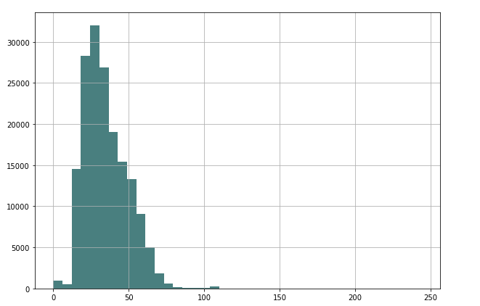
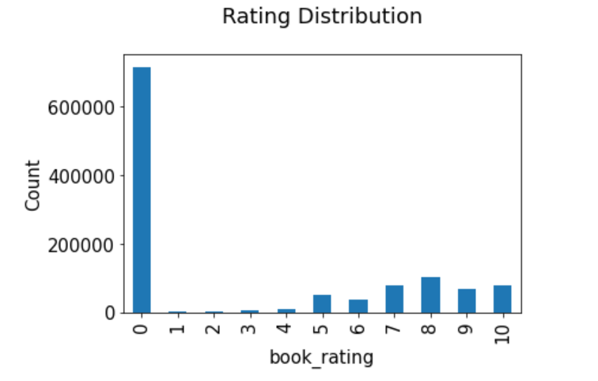
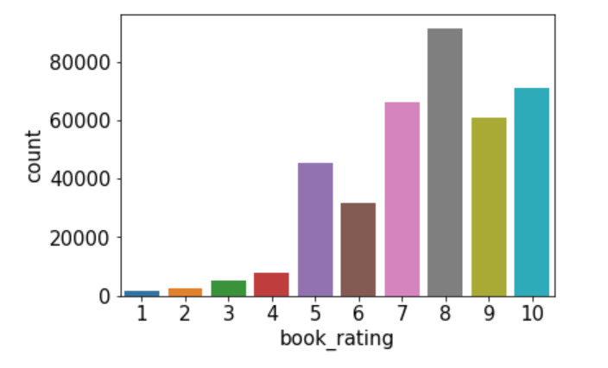
Age : As we can notice some user ages were below 5 and above 90, which is not useful for our analysis
The highest ratings are more used and rating height is the rating mostly present.

Slide 9
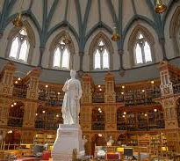

Exploring the Data

Slide 10
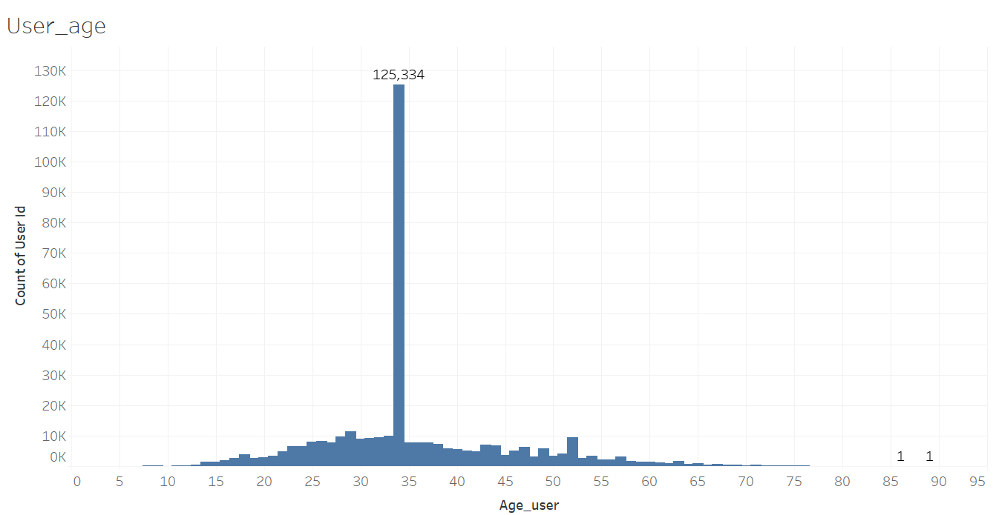
Using Tableau
Visualisation of the dataset : preprocessed.csv

Slide 11
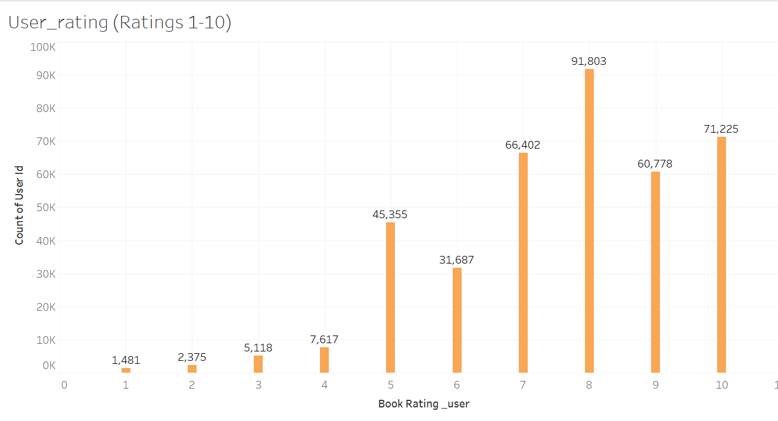
User_rating :

Slide 12
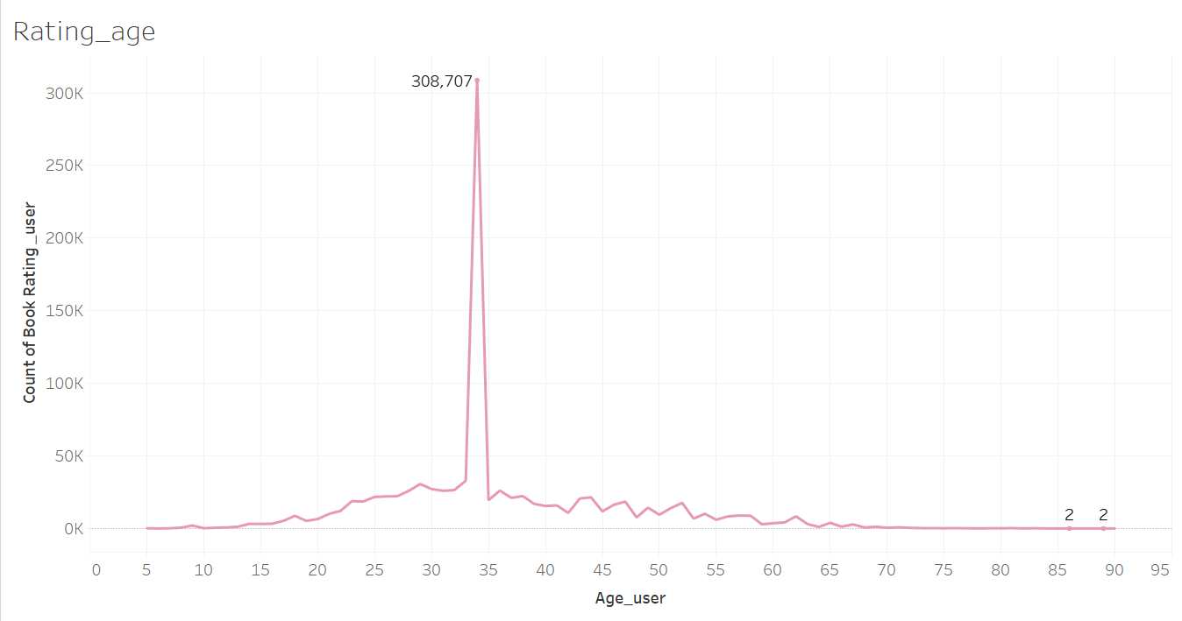
Ratings User/age :

Slide 13
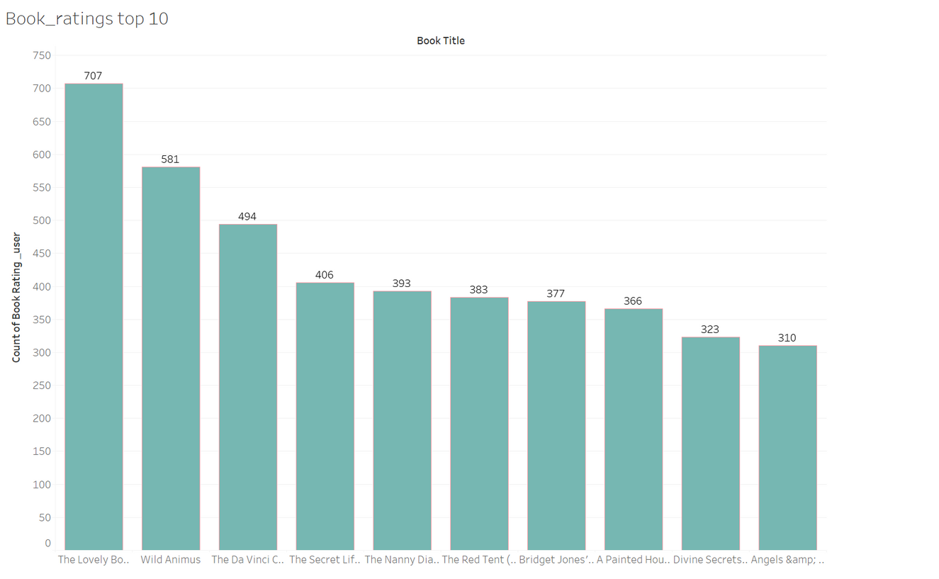
Top 10 books :

Slide 14
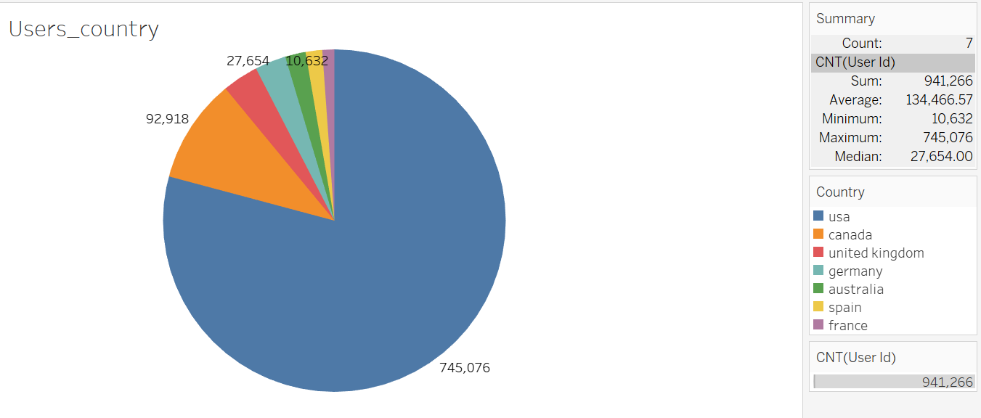
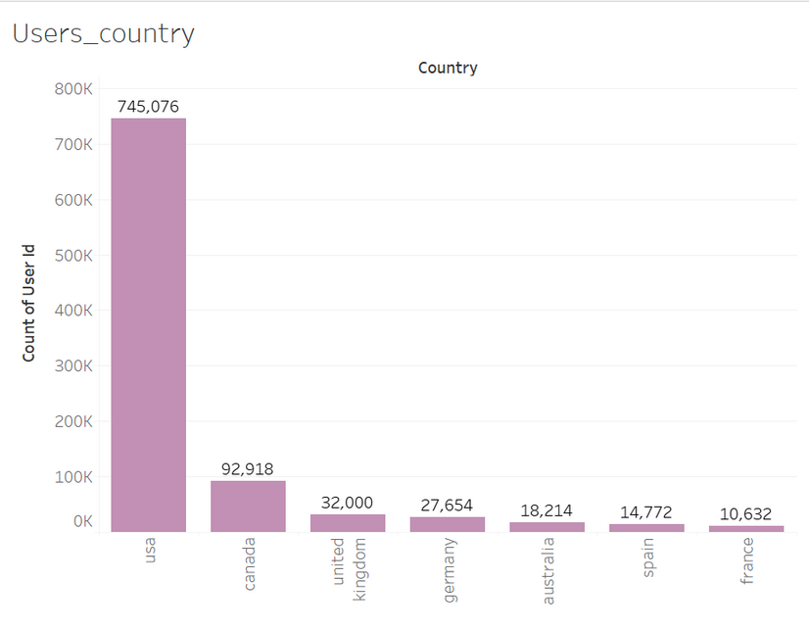
Users per country

Slide 15
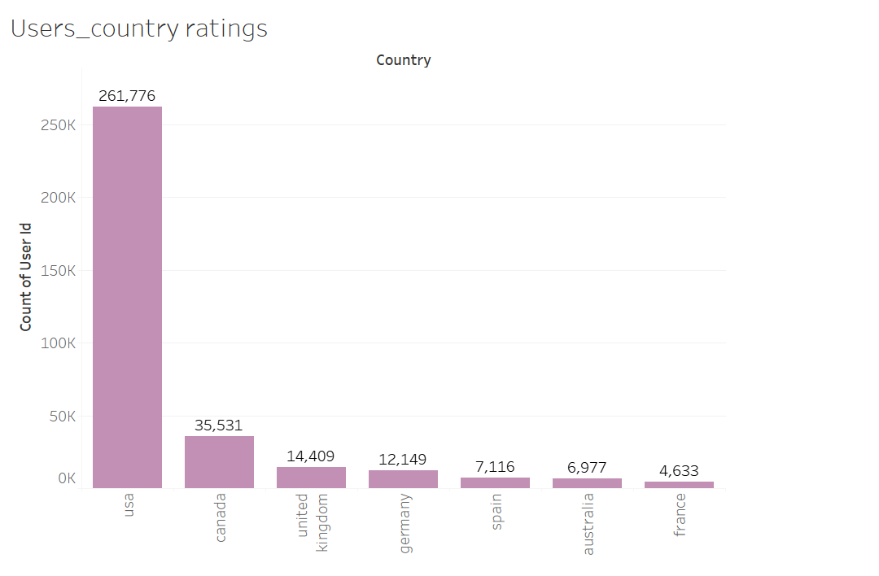
Ratings per country :

Slide 16
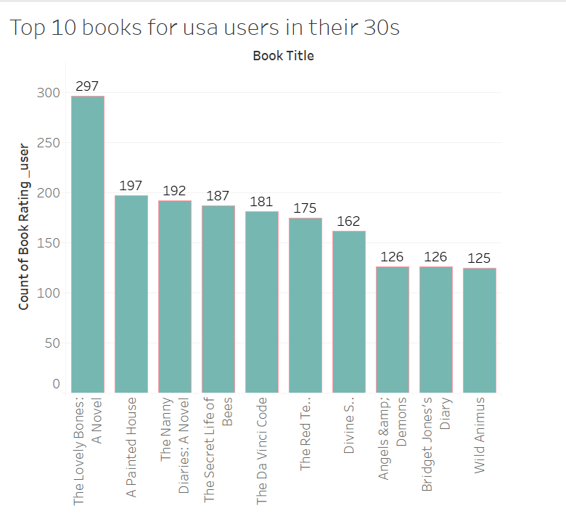
Top 10 books for american users in theirs 30s

Slide 17

Recommendation
System
Simple recommenders
Collaborative Filtering based Recommendation System
User-based recommendation book system
Collaborative Filtering Using k-Nearest Neighbors

Slide 18





What actually is Recommendation System?
Machine learning which offers relevant suggestions to the customer. Before the recommendation system, the major tendency to buy was to take a suggestion from friends. But Now Google knows what news you will read, Youtube knows what type of videos you will watch based on your search history, watch history, or purchase history.

Slide 19
Types Of Recommendation System :
Collaborative Filtering
Content-Based Filtering
Hybrid Recommendation Systems
Simple recommenders:
Generalized recommendations to every user, based on book popularity and/or genre.

Slide 20
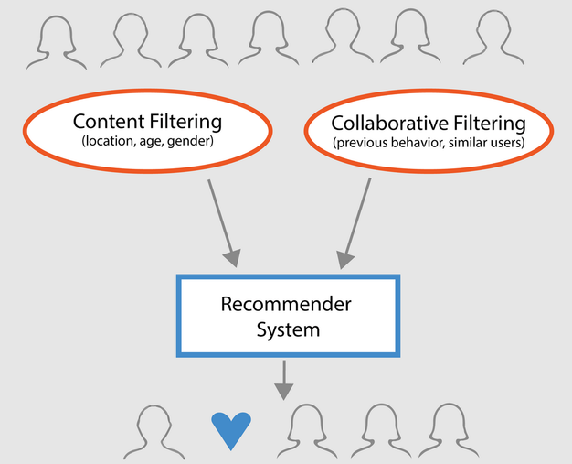
it is based on past interactions of users and target items.
Example: YouTube
Collaborative-based Filtering :
Content-Based Filtering
This algorithm tries to find items which look alike (e.g. similar ages, categories).

Slide 21
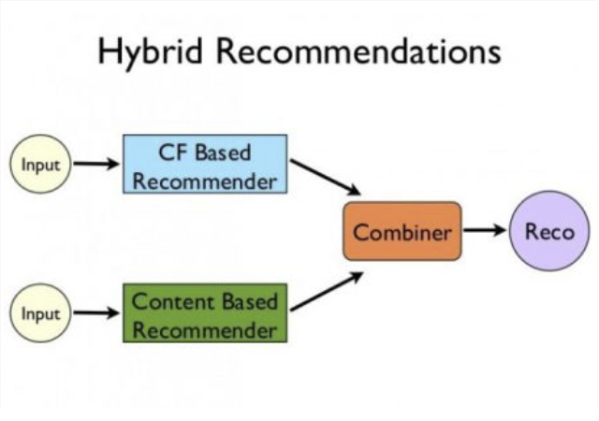
Hybrid Filtering Method :
It is basically a combination of both of the previous methods.

Slide 22
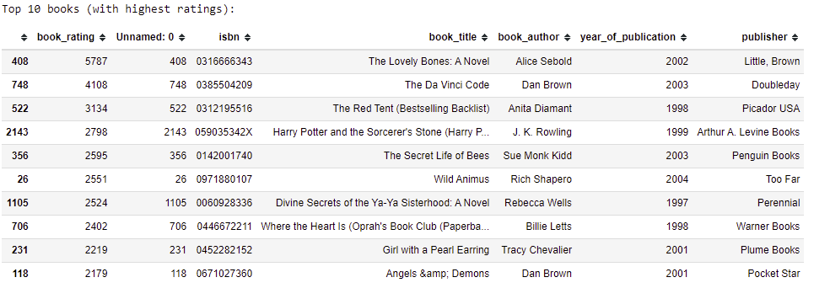
Simple Popularity based Recommendation System :
Recommendations based on ratings

Slide 23
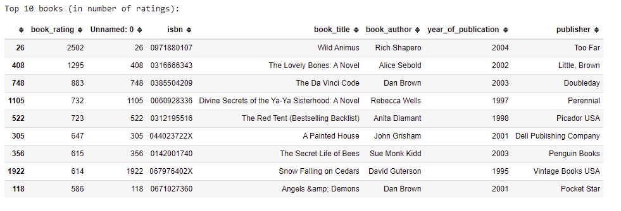
Recommendation based on popularity

Slide 24
User-based recommendation book system:
returns similarities and indices of similar users.
Predicte ratings for specified user-item combination based on user-based approach..
We are using any user from the list that we are getting.
Then we utilises above functions to recommend items for item/user based approach and cosine/correlation. Here recommendations are made if the predicted rating for an item is >= to 6, and the items have not been rated already.
Checking for incorrect entries and getting the list User_id that should be a valid integer .
Then using this list we can get recommended books for a specifique users

Slide 25
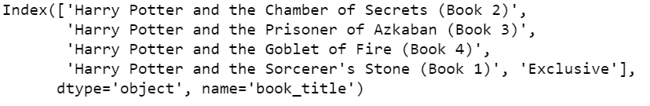
Collaborative Filtering Using k-Nearest Neighbors (kNN)
Collaborative Filtering Using k-Nearest Neighbors (kNN) kNN is a machine learning algorithm to find clusters of similar users based on common book ratings, and make predictions using the average rating of top-k nearest neighbors.

Slide 26
Conclusions:
For this project I tried to use a different approach for the book recommendation system.
As we can see, depending on the one we choose, recommended books are not the same, and the complexity of the system is different.
Now I have a better understanding of what YouTube, Netflix, etc... are recommended for me and why.
Over all, I felt that this was a good choice for a project. The problem was interesting to me and advanced enough to challenge me to learn more about data cleaning, how to deal with a large data set and machine learning algorithms used in recommendation engines.

Slide 27
https://github.com/SophieHubert/Recommended-Reading.git
Sophie Hubert
Thank
You !

